Slide 1
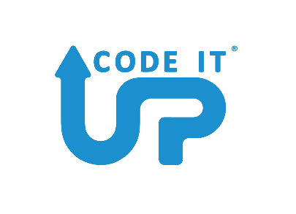

Let's Get Functional With C#
Code It Up Online Vol. 7

Slide 2
For questions
https://sli.do #func
The YouTube Live Chat Is Not Monitored
Presentation & Code https://github.com/ivaylokenov/Let-s-Get-Functional-With-C-Sharp

Slide 3
Live stream troubleshooting
Sometimes issues happen during a live stream…
And sometimes disasters happen, this is how memes are born…
If my Internet goes down and the stream stops:
Wait for 5 minutes, I have another one on a different network
If YouTube is showing “stream ended”:
I will post a new link in the comments section below this video
If something else happens unexpectedly:
Well, I will add a solution to this slide during my next event… ☹
If a major showstopper is happening – no electricity, for example
I will create a new event and we will schedule a new live stream…

Slide 4
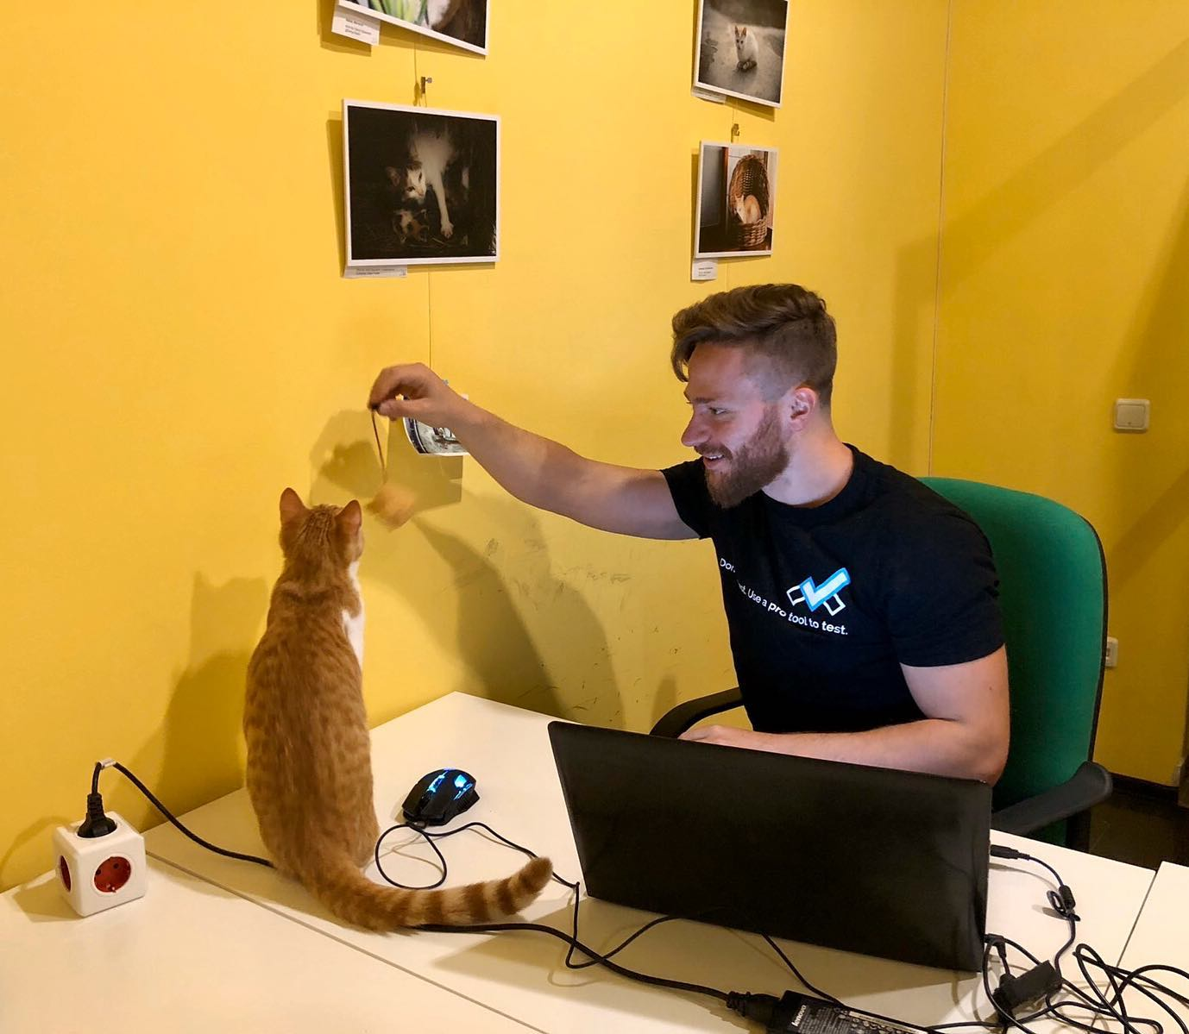
The Presenter
Ivaylo Kenov – Quality Code Advocate
Various job titles at the same time:
Organizer & Speaker @ Code It Up
CTO @ SoftUni
Full Stack Technical Trainer @ Everywhere
Code General @ https://MyTestedASP.NET
Meme Copy Machine @ Daily Programming Fun
{Insert Job Title Here}
Contacts
https://github.com/ivaylokenov
https://facebook.com/ivaylo.kenov
https://linkedin.com/in/kenov
https://www.instagram.com/ivaylokenov/
YouTube
https://youtube.com/MyTestedASPNETTV

Slide 5
Sponsors
This lecture is free thanks to our sponsors
Which will interrupt the lecture here and there
Because it takes quite a lot of personal time to prepare the materials
You will help the initiative a lot if you visit their web sites
And consider their propositions to you
I personally select various premium jobs to present them during the talk
These are the current ones:
Solution Architect @ INDEAVR - https://indeavr.com/positions/solutions-architect/
Remote .NET Team Lead @ MentorMate - http://bit.ly/mm-job1
Remove Senior Full Stack .NET Developer @ MentorMate - http://bit.ly/mm-job2

Slide 6
What Are We Going To COVER
About Code It Up
Caution About The Topic
Why Functional Programming
The Basic Requirements In C#
Common Concepts
Thinking Functionally
Functional Techniques
Functional Abstractions
Monads From Practice
Practical Applications
Going Even Further
Functional Libraries

Slide 7
ABOUT CODE IT UP

Slide 8
Code it up
The Code It Up initiative:
Aims to provide detailed knowledge on advanced software development topics
Aimed at people with at least 1 year of C# experience
Code It Up Online
Free live-streamed online events
Led by me – mainly .NET, architecture, and infrastructure
Code It Up Guests
Free live-streamed online events
Guest speakers from the industry
Variety of technologies
Code It Up Workshop
Paid events containing theory & practical exercises for the attendees

Slide 9
Upcoming Code it up Events
Next events:
Enter the Swarm - Native Docker Clustering
Events with no specific order or dates:
Automate Your Process with CI/CD
The Limits of the C# Runtime
API Scenarios - REST, GraphQL & gRPC
Serverless Real-Time C# Applications On AWS? Yes, It’s Possible & Easy!
Software Engineering – Patterns & Anti-Patterns
Plus many more! For example Microservices Details?

Slide 10
Thankful if you share a story
You can be extremely helpful to the initiative
Just share a story on Facebook or Instagram during the lecture
Make sure you tag me so that I can reshare your post - @ivaylokenov
Bonus – add the #codeitup hashtag
Thank you! You rock!

Slide 11
caution

Slide 12
Be careful with Functional programming
Functional programming may be fun and games…
But C# is still OOP-first!
I do not suggest or disapprove any of the presented practices!
The shown techniques push the limits of the C# language...
Therefore, some of them may seem quite strange at first…
Always consider such practices as a team with your colleagues!
If you decide to use them, make sure you are consistent within your code base!
Also, please help me with the late guys in the YouTube chat! ☺

Slide 13
Why Functional programming?

Slide 14
Why Functional programming?
Because:
It is an interesting style
Very helpful in data-driven applications
Can be used in functional languages like F#
Better source of truth in terms of code understanding
Testing is easier in practice
Debugging is easier in theory
Fewer side effects and less bugs
Concurrent applications benefit from functional programming
As I grew and advance as developer, I tend to write more functional code and follow its paradigms

Slide 15
What is Functional programming?
Main ideas:
Pure functions
Declarative programming
Small cohesive pieces of code
Method signature honesty
Functional programming is a paradigm which concentrates on computing results rather than on performing actions. That is, when you call a function, the only significant effect that the function has is usually to compute a value and return it. Of course, behind the scenes the function is using CPU time, allocating and writing memory, but from the programmer’s point of view, the primary effect is the return value.

Slide 16
Downsides of Functional programming
Learning curve
Not enough learning resources
Writing pure functions is easy, composing a fully working application is not
Immutable state forces us to write more code
Functional programming and I/O operations do now mix very well
Purity is lost
Immutable values and recursion lead to more memory usage
It is not always pragmatic
Debugging is more difficult in practice

Slide 17
Why functional programming in c#?
Why not using a functional language directly?
Why should we bother if we are C# developers?
Well, many reasons:
You may have a small project and want to experiment a bit
You may have a legacy project and want to extract some functional parts
You are already using functional concepts (LINQ, for example)
You may like the C# syntax (some functional languages are a bit strange)
Improve the asynchronous programming beyond TPL
C# is functional language; it is just OOP first!
You may find your passion for functional languages from your comfort zone!
Nowadays, we do not care that much for memory consumption!

Slide 18
The basic requirements in c#

Slide 19
Lambda functions and delegates
To understand this lecture, you should be familiar with lambda functions
Basically, this method:
Can be shortened and stored in a variable:
public static int Sum(int x, int y)
{
return x + y;
}
Func<int, int, int> sumFunc = (x, y) => x + y;
var sumFuncHack = Func((int x, int y) => x + y); // this requires a custom method

Slide 20
Common concepts

Slide 21
Common concepts
Immutable types
Types should have immutable internal state as much as possible
Changing a value should lead to a new instance
Thread-safe type out of the box
Makes sure we prevent misuse
Do not mutate properties, return new instances
Expressions instead of statements
Using expressions allows us to skip variable creation
Less verbose code
Much shorter and readable
Closure
Local scope of the function

Slide 22
Common Concepts
Higher order functions
Function that takes other functions as arguments
Or returns a function
Very powerful concept
Can be used to abstract common functionality
LINQ uses this concept
Functional composition
Combining single functions to build more complicated ones
The result of each function is passed as an argument to the next
The final result is the most outer call
In C# composition looks a bit ugly but there are libraries to help

Slide 23
Common Concepts
Method Chaining/Pipelining
Passes results from one function to another
Every function creates a new object
For example, LINQ (with extension methods) or StringBuilder (with the fluent builder pattern)
Declarative instead of Imperative programming
We do not care how we accomplish things
We care about the end results
Comparing a loop to a LINQ statement
Super important aspect and you should think about it when you write code
Immutable collections
With shared parts of memory
https://stackoverflow.com/questions/927181/immutable-collections/927219#927219

Slide 24
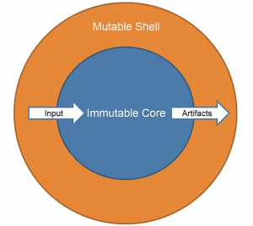
But when do we mutate state?
How to achieve state mutation?
The whole idea of an application is to store and update state
For this reason, we need to separate our application to code that is pure
The Redux JavaScript pattern is a good example here

Slide 25
BEFORE WE CONTINUE…

Slide 26

INDEAVR – The EVENT’s DIAMOND SPONSOR
They provide technology services focused on the Digital, Data, Cloud and Advanced Software Engineering expertise.
They are always in search for creative and passionate people with the combination of a sharp strategic mind, emotional maturity, entrepreneurial instincts, and the ability to deliver results.
https://www.indeavr.com/en/technology/application-services
https://www.indeavr.com/en/careers

Slide 27
Thinking functionally

Slide 28
Changing the way you think
Functional programming is not just stylistic preference
It is a completely different way of thinking about programming
C# is objects-first making it difficult to change your classic habits
It is critical to think functionally, not imperatively
Do not be super afraid, if you are not an experienced programmer
This concept is difficult for everyone at the beginning
Try to take whatever you can and re-learn the material in a couple of days
Write down some simple code examples and try to improve them over time

Slide 29
Let's start with mathematics
Functional programming comes from mathematics
A mathematical functions has the following characteristics:
A function always gives the same output value for a given input value
A function has no side effects
In typical programming, we think that a function "do some calculations"
But in mathematics, a function is purely a mapping from an input to an output
There are also two other seemingly unhelpful properties:
The input and output values are immutable
A function has exactly one input and one output
These two properties are mirrored too!

Slide 30
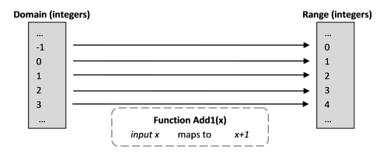
Let's start with mathematics
Some terminology:
The input is called a "domain"
The output values are called "range"
The function is set to "map" the domain to the range

Slide 31
Let's start with mathematics
Notice the "map" wording
A mathematical function is just like a lookup without any calculations
Consider the function:
It can be defined like this:
int AddOne(int input) => input + 1
int AddOne(int input) {
switch (input) {
case 0: return 1;
case 1: return 2;
// continues to infinity
}}

Slide 32
Let's start with mathematics
In mathematics when you add a value, you do not expect to change the original number
We do not expect "x" to change by adding a value to it
But how to have immutable input and output?
It is not that difficult - it will be explained in practice!
And how to have exactly one input or output?
We want multiple arguments?
This technique is called "currying" and it will be explained shortly!
x = 5
y = x + 5

Slide 33
Let's start with mathematics
The mentioned properties define the so called "pure functions":
You can parallelize them trivially – no locks, shared state and race conditions
You can evaluate the function lazily – only when you need the answer as it will not change
You can cache the result for certain input – the output will always be the same
You can evaluate multiple pure functions in any order you want – the final result will be the same
All the above benefits are quite useful
And you can accomplish them in C# without any issue

Slide 34
Function values
In terms of functional programming, the input is not a "variable"
When we pass values to the input, we are essentially binding these values
This is not an assignment like we do with variables
Binding the value means it cannot change
AddOne(5)
// bind 5 to the input
// replace "input" with "5"
// AddOne(5) == 5 + 1 == 6
// result is 6

Slide 35
Function values
There are no variables in functional programming terminology, only values
The function name "AddOne" is also bound to "the function that adds one to its input"
"AddOne" is called a function value and it is here just to help us
Because it does not matter what is the name of the function:
It is important to understand that functions are also values
They are just bound to names and passed around
Even as inputs or outputs to other functions
Func<int, int> plusOne = AddOne;
var result = AddOne(5);
var result = plusOne(5);

Slide 36
Values vs objects
Values:
Members of the domain (of integers, of strings, of functions which map strings to integers, etc.)
Values are immutable
Values do not have any behavior attached to them
Object:
Data structure to store state and its behavior (methods)
Expected to change state
Operations change internal state via the object itself (the "." operator)
We want to avoid using "objects" for the functional aspects of our program
We should use "objects" only for true classes with methods

Slide 37
Functions as types in C#
A function is pretty much defined by "domain -> range".
In C# this is written like this:
We can then use this type to create higher order functions with inputs:
Func<domain, range>
int EvalWithFiveAndAddTwo(Func<int, int> eval) => eval(5) + 2;
Func<int, int> timesThree = x => x * 3; // A function of type (int -> int)
int result = EvalWithFiveAndAddTwo(timesThree)

Slide 38
Functions as types in C#
And higher order functions with outputs:
The signature is:
Example:
Func<int, int> Adder(int number) =>
x => x + number;
int -> (int -> int) // Func<int, Func<int, int>>
var addOne = Adder(1);
var addTwo = Adder(2);
var firstResult = addOne(5); // 6
var secondResult = addTwo(7); // 9

Slide 39
Tuple types
The tuple types are commonly used with functional programming
They represent pairs, triples, etc. of other types
For example, ("George", 25) is a tuple of string and integer
The comma is a tuple character
If you see a comma, you have a tuple
The method parameters is a tuple, if you think about it
Since C# 7.0, tuples have first-class support:
(double Sum, int Count) t2 = (4.5, 3);
Console.WriteLine($"Sum of {t2.Count} elements is {t2.Sum}.");

Slide 40
BEFORE WE CONTINUE…

Slide 41
Huge THANKS for your support & TRUST!
Everyone who got a paid ticket – 68 people in total! Thank you!
Top supporter – Ivo Paunov – 120 BGN! Thank you, man, you rock! <3
Personal thanks to – Georgi, Yanka, Борислав, Mary, Svetoslav, Mitko
Thanks also to – Iliyan, Todor, Atanas, Rosen, Daniel, Minko, Ivaylo, Martin, Георги, Boyan, Valeri, Пламен, Kosta, Dimitar, Yavor, Dimitar, Pavel, Miroslava, Hristo, Dobromir, Petar, Bozhidar, Teodor, Deyan, Georgi, Gabriela, Mincho, Ivaylo, Ivo, Petya, Velizar, Pavel, Veselin, Andrey, Andrey, Djengiz, Marin, Vanya, Adrian, Ilina, Georgi, Dinyo, Petko, Mariyan, Anna, dimitar, Диана, Zlatko, Grigoris, Stoyan, Ivaylo, Dimitar, Lyubomir, Mira, Todor, Hristo, Hristina, Veselin, Vladimir, Радослав, Diyan, Ивайло
And everyone who supported the initiative back in 2020!

Slide 42
These events are not Exactly free
I prefer to call them “Pay what you want”
Depending on how much you value the provided knowledge
It takes me a considerable amount of free time to prepare these lectures
And I want them to be perfect and complete!
I put my soul in them!
For this reason, I will be extremely thankful, if you decide to support me and my projects!
It is never expected, but always appreciated!
The easiest way is via
PayPal: http://paypal.me/ivaylokenov
Revolut: @ivaylowrlt

Slide 43
Mentorship program ON Patreon
These events are part of my mentoring program!
Target – junior to regular programmers with 0 to 2 years practical work
Help with:
Becoming better software developers
Code improvement in terms of quality and logic
Career choices, advancement, and interview preparation
And many more, sky is the limit!
60% off around the free Code It Up events!
Approach – private groups, exclusive lessons, workshops, one-on-one meetings
More information on Patreon: https://www.patreon.com/ivaylokenov

Slide 44
Functional techniques

Slide 45
Various techniques
There are many techniques in functional programming:
Currying – separating a function to multiple calls with a single parameter
Partial application – invoking a function partially
Composition – combining multiple functions into a single one
You can create generic helper functions to abstract these concepts
Create them only if you need them
Follow a single standard but both camel case and pascal case are fine
You may create these functions as extension methods too
Note: static methods have some limitations in C# and they require populating the generic arguments implicitly

Slide 46
Inferring lambda generic types
Before we start talking about the techniques in detail we may consider improving the "Action" and "Func" syntax:
Func<int, int, int, int> func = (x, y, z) => x + y + z;
public static Func<A, B, C, R> func<A, B, C, R>(Func<A, B, C, R> func) => func;
public static Func<A, B, C, R> Func<A, B, C, R>(Func<A, B, C, R> func) => func;
var function = func((int x, int y, int z) => x + y + z);

Slide 47
Currying
Let's get back to the mathematical property of functions with a single input
We can do this in C# in two ways:
Passing a tuple of arguments as a single parameter
A function with multiple parameters rewritten as series of new functions with a single parameter
The second approach is named after Haskell Curry
Mathematician with huge influence on the functional programming concepts
Func<int, Func<int, int>> sum = x => y => x + y;
var result = sum(1)(2); // 3

Slide 48
Currying
Let's examine the examples in more detail:
Construct a value called "sum" which is a Func with only one parameter "x"
Inside it, construct a sub-function which has one parameter too – "y"
The sub-function can access "x" because it is in scope
Return the newly created sub-function
Step by step version:
static Func<int, int> sum(int x) {
int partial(int y) {
return x + y;
}
return partial;
}

Slide 49
Currying
You can create a generic helper currying function:
public static Func<A, Func<B, R>> curry<A, B, R>(Func<A, B, R> func)
=> (A a) => (B b) => func(a, b);
public static Func<A, Func<B, R>> Curry<A, B, R>(Func<A, B, R> func)
=> (A a) => (B b) => func(a, b);
public static Func<A, Func<B, Func<C, R>>> curry<A, B, C, R>(Func<A, B, C, R> func)
=> (A a) => (B b) => (C c) => func(a, b, c);
public static Func<A, Func<B, Func<C, R>>> Curry<A, B, C, R>(Func<A, B, C, R> func)
=> (A a) => (B b) => (C c) => func(a, b, c);

Slide 50
Partial application
Partial application is the natural currying successor
The idea is to have a function with multiple parameters
And if you fix the first N, you will receive a function with the remaining ones
Partial application is very powerful and flexible
You can create abstract reusable functions with it

Slide 51
Partial application
You can create a generic helper partial application function:
public static Func<B, C, R> partial<A, B, C, R>(Func<A, B, C, R> func, A a)
=> (B b, C c) => func(a, b, c);
public static Func<B, C, R> Partial<A, B, C, R>(Func<A, B, C, R> func, A a)
=> (B b, C c) => func(a, b, c);
public static Func<C, R> partial<A, B, C, R>(Func<A, B, C, R> func, A a, B b)
=> (C c) => func(a, b, c);
public static Func<C, R> Partial<A, B, C, R>(Func<A, B, C, R> func, A a, B b)
=> (C c) => func(a, b, c);

Slide 52
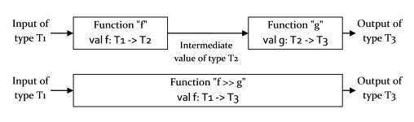
Function composition
Function composition sounds quite intimidating at first
But it is actually quite simple
Say that you have a function "f" that maps from type "T1" to type "T2", and say that you also have a function "g" that maps from type "T2" to type "T3". Then you can connect the output of "f" to the input of "g", creating a new function that maps from type "T1" to type "T3".

Slide 53
Function composition
Here is an example:
static float RoundToInt(double number) => (int)Math.Round(number); // double -> int
static bool CheckIfEven(int integer) => integer % 2 == 0; // int -> bool
static bool RoundAndCheckIfEven(double number) { // double -> bool
var integer = RoundToInt(number);
return CheckIfEven(integer);
}
static bool RoundAndCheckIfEven(double number) => RoundToInt(CheckIfEven(number));
var firstResult = RoundAndCheckIfEven(1.2); // false
var secondResult = RoundAndCheckIfEven(1.6); // true

Slide 54
Function composition
You can create a generic helper composition function:
public static Func<A, C> compose<A, B, C>(Func<A, B> a, Func<B, C> b)
=> x => b(a(x));
public static Func<A, C> Compose<A, B, C>(Func<A, B> a, Func<B, C> b)
=> x => b(a(x));
public static Func<A, D> compose<A, B, C, D>(Func<A, B> a, Func<B, C> b, Func<C, D> c)
=> x => c(b(a(x)));
public static Func<A, D> Compose<A, B, C, D>(Func<A, B> a, Func<B, C> b, Func<C, D> c)
=> x => c(b(a(x)));

Slide 55
BEFORE WE CONTINUE…

Slide 56
Code It Up workshops
C# Multithreading Workshop – 5 hours video + 20 pages guidebook
DDD & Clean Architecture with ASP.NET – 12 hours video + 70 pages guidebook
Kubernetes for Web Developers – 6 hours video + 52 pages guidebook
Becoming a Software Architect – 8 hours video + 100 pages guidebook (WIP)
Just shoot me a message – wewritesoftware@gmail.com
And I will give you more details!
More workshops are coming!
Clean Code, Security, Machine Learning, and more…

Slide 57
Functional abstractions

Slide 58
This is where it gets mind-boggling!
The next few concepts are quite abstract and difficult at first
Just let them sink in for a couple of days
You are not a bad programmer, if you do not get them right away
Remember that we needed to learn what is polymorphism at some point
The problem with functional programming is that it has lots of unfamiliar vocabulary
Every person has their own learning path to the knowledge
And most of the time tutorials cover only part of it
So, keep calm and listen to your teacher!

Slide 59
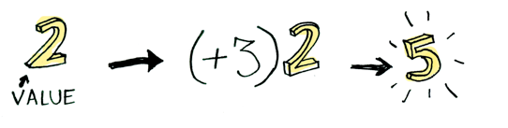
Let's start with known stuff!
All the images from this section are taken from this Haskell tutorial:
https://adit.io/posts/2013-04-17-functors,_applicatives,_and_monads_in_pictures.html
I just converted it to a C# version to be more familiar to .NET developers!
Let's start with a simple value and applying a function to it:

Slide 60
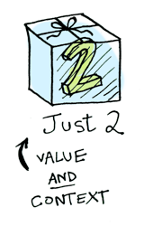
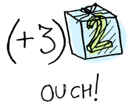
Values in context
Let's extend that and put the value in some context
For example - nullable value, value in an array, value in a Task/Promise/Future/Observable, etc.
We cannot apply a normal function to it
Because the context is not the value!
int? value = 42; int[] arr = new [] { 42 }; Task task = Task.FromResult(42);
var result = Task.FromResult(42) + 10; // Does not compile!

Slide 61
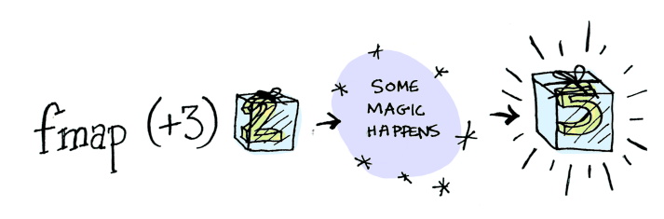
Mapping Values in context
Tasks are quite advanced, so let's use nullable value and value in an array
They will be our contexts, containers, boxes, etc.
We want to have a function "map" allowing us to change the values
And keep them in their original context
var box = new[] { 42 };
int? container = 42;

Slide 62
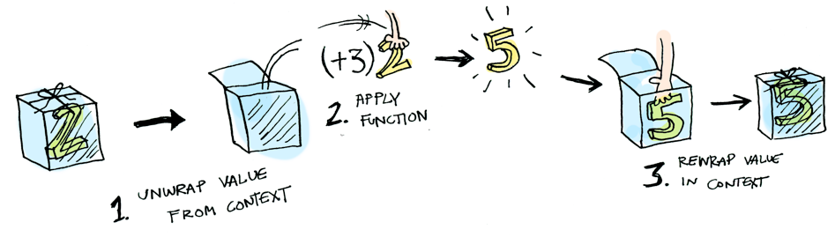
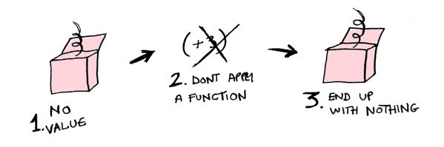
Mapping Values in context
Here is what will happen behind the scenes:
It should work with empty containers too:

Slide 63
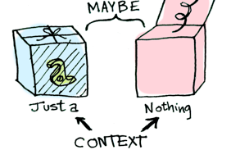
The maybe type
Creating a "map" function for our scenarios is pretty straightforward
However, the default nullable type is not flexible enough, so let's create our own
It will help us deal with nullable paths in a more fluent way
Maybe or Optional type
With its own "map" function

Slide 64
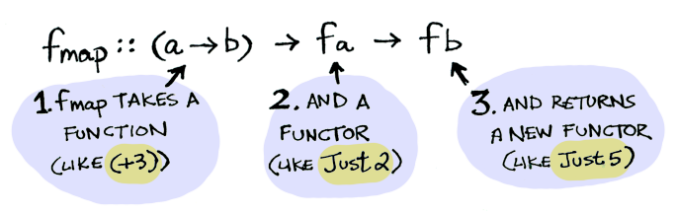
functors
We've come to the first major terminology – Functor
A Functor is any data type that it defines how "map" applies to it
In other word, a Functor is anything that is "mappable"
All values in contexts are functors
The "map" function receives a function, and functor and returns a functor

Slide 65
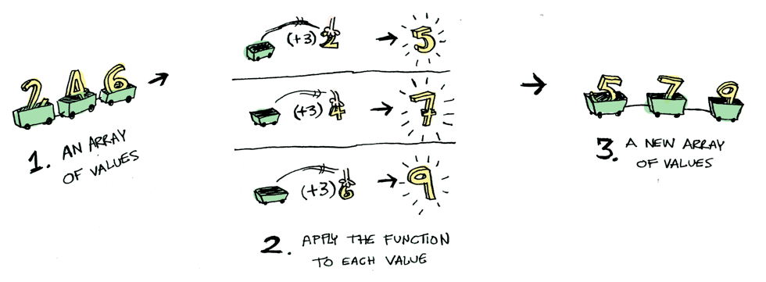
functors
The array is a functor
The nullable type is a functor
Our Maybe class is a functor
Other "mappable things" can be functors...
public static Functor<TResult> Map<TInput, TResult>(Functor<T> input, Func<T, TResult> mapping);

Slide 66
Generic functor
We can abstract the "map" of the numbers array to a more generic version
By using the built-in IEnumerable<T> interface:
public static IEnumerable<TResult> Map<TInput, TResult>(
this IEnumerable<TInput> input,
Func<TInput, TResult> mapping)
{
foreach (var item in input)
{
yield return mapping(item);
}
}

Slide 67
The functor abstraction
The "map" function is just a concrete example
If we take this concept abstractly, Task is also a Functor
Even though it does not have a direct "map" method
But why?
Task is a container of a wrapped value
It encapsulates eventual result of an asynchronous operation
Task has an interface where we can apply functions to the wrapped value
You can use "ContinueWith" and other methods to interact with the value
If you think about it "ContinueWith" also "maps" the value with a function and returns a Task
Therefore, Task is also a Functor

Slide 68
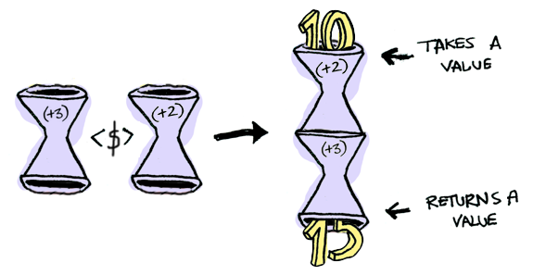
Functions and functors
Functions are also Functors... Wait, what?
What happens when we "map" a function with another function?
Remember function composition?
We take two functions, pass them to another function which return what?
A function!

Slide 69
Functor Laws
There are some intuitive functor laws:
The original functor must be unchanged by the "map" function
If you have two functions, "mapping" over one after the other should be the same as "mapping" over the composition of the functions
Functor examples:
Maybe functor
Tree functor
Lazy functor
And many more…

Slide 70
Functor and map disadvantages
If we have nested functors, it gets messy:
We need another pattern… Monads to the rescue!
IEnumerable<IEnumerable<Cat>> catsFromOwners
= GetOwnersList().Map(owner => owner.Cats);
Maybe<IEnumerable<IEnumerable<Cat>>> maybeCatsFromMaybeOwners // the "maybe" prefix is optional
= GetOwners().Map(maybe => maybe.Map(owner => owner.Cats));
Maybe<Maybe<string>> maybeAddressesFromMaybeOwners // the "maybe" prefix is optional
= GetOwner().Map(owner => owner.Address);

Slide 71
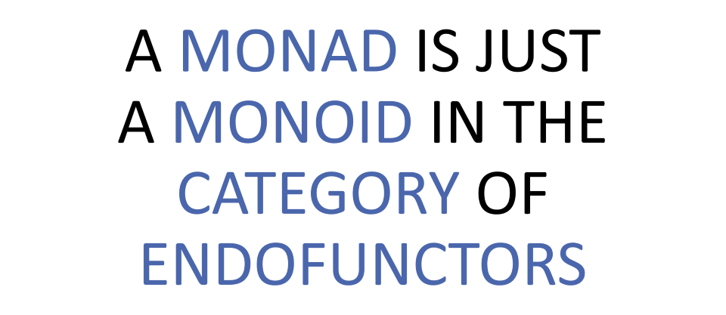
Monads Introduction
Now, let's move to the Monad design pattern
Here is a short explanation:
Aaaa… Wut?!

Slide 72
Monads Introduction
The previous definition requires a lot of theoretical knowledge
It is both mathematically correct and extremely useless for beginners
As every programmers, we do not need that much theory and definitions
We need practicality in 99% of our work!
So, let's start with a simpler explanation:
A bit simpler, but we need to break it down…
Monads apply a function that returns a wrapped value to a wrapped value.

Slide 73
Monads and flatmap/bind
We need a "flatMap" function to make that work
The official name is "bind", but we want to keep naming simple and consistent
The function "unwraps" and then "maps", therefore the "flatMap" name
Let's say we have the following half function working only on even numbers:
Func<int, Maybe<int>> maybeHalfFunction
= func((int number)
=> number % 2 == 0
? number / 2
: Maybe<int>.None);
// We can use other functors too - arrays, lists, IEnumerable, etc.

Slide 74
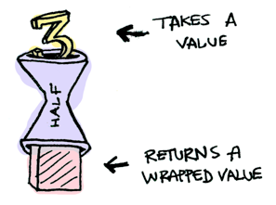

Functions returning wrapped values
The half function is quite straightforward:
However, it does not work with wrapped values:

Slide 75
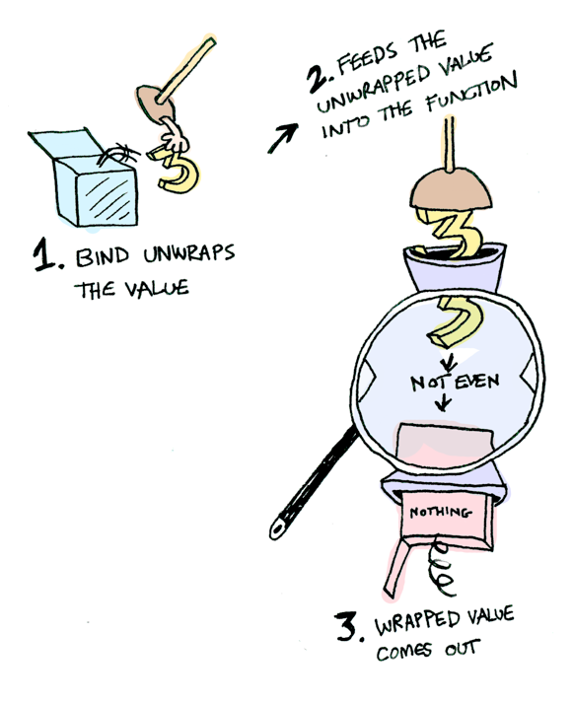
The flatmap/bind function
We need to use the "flatMap" function to pass the wrapped value:
Maybe<int> halfMaybe = maybeNumber.FlatMap(maybeHalfFunction);

Slide 76
The flatmap/bind chaining
We can easily chain the "flatMap" function
Without having the "nesting" issue
We cannot use the original "map" because the half function returns a wrapped value
But why do we return a wrapped value at the first place?
To allow "chaining" of functors without the "nesting" disadvantage
Maybe<int> maybeChaining = new Maybe<int>(64)
.FlatMap(maybeHalfFunction)
.FlatMap(maybeHalfFunction)
.FlatMap(maybeHalfFunction)
.FlatMap(maybeHalfFunction);

Slide 77
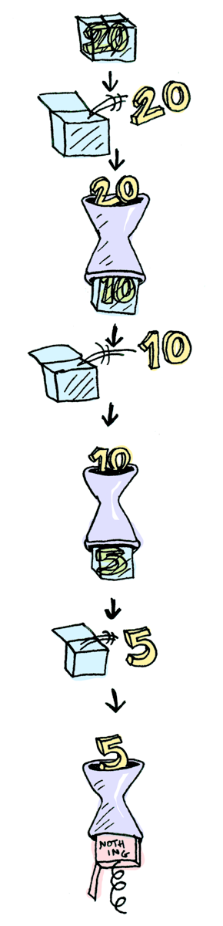
The flatmap/bind chaining

Slide 78
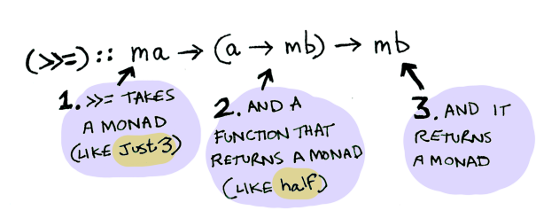
The monad explained
And this was the Monad design pattern
You can apply it on various different scenarios
Keep in mind both "map" and "flatMap" are useful depending on the use case

Slide 79
The monad abstraction
Here is the abstract C# Monad signature:
We can then implement it for various scenarios:
IEnumerable
Tasks
Maybe
And more…
public static Monad<TResult> FlatMap<TInput, TResult>(
this Monad<TInput> input,
Func<TInput, Monad<TResult>> mapping)

Slide 80
The generic ienumerable monad
And here is the IEnumerable implementation:
public static IEnumerable<TResult> FlatMap<TInput, TResult>(
this IEnumerable<TInput> input,
Func<TInput, IEnumerable<TResult>> mapping)
{
foreach (var item in input)
{
foreach (var mappedItem in mapping(item))
{
yield return mappedItem;
}
}
}

Slide 81
Dissecting LINQ
C# developers have been using these functional concepts since forever
LINQ and IEnumerable are essentially the C# way of doing collection Monads
The "Select" extension method is the C#'s "map"
The "SelectMany" extension method is the C#'s "flatMap" or "bind"
LINQ removes the need to write lots of imperative code
You can easily convert loops to expressions
And by adding the Maybe monad, you can convert conditional statements too
With some additional helper methods like "Match", for example

Slide 82
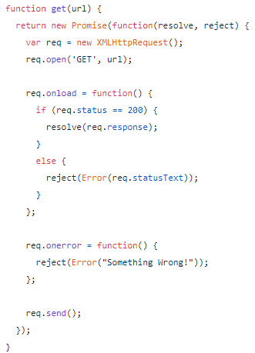
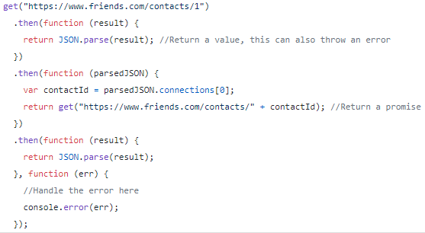
Another popular example of map and bind

Slide 83
MONADs from practice

Slide 84
Let's say we have a domain
We have an academy:
class Academy {
Student GetStudent() { … }
}
class Student {
Course GetCourse() { … };
}
class Lecture {
Lecture GetLecture() { … };
}
class Lecture { … }

Slide 85
We can easily chain it
The workflow is quite straightforward:
Student student = academy.GetStudent();
Course course = student.GetCourse();
Lecture lecture = course.GetLecture();
// Or with fluent syntax
var lecture = academy
.GetStudent()
.GetCourse()
.GetLecture();

Slide 86
We Need to add Null checks
We need to defend against null related issues:
Student student = academy.GetStudent(); if (student == null) return;
Course course = student.GetCourse(); if (course == null) return;
Lecture lecture = course.GetLecture(); if (lecture == null) return;
// Or with fluent syntax
var lecture = academy
?.GetStudent()
?.GetCourse()
?.GetLecture();

Slide 87
What about collections?
If we wanted to use collections, we will have this code:
class Academy {
IEnumerable<Student> GetStudents() { … }
}
class Student {
IEnumerable<Course> GetCourses() { … };
}
class Lecture {
IEnumerable<Lecture> GetLectures() { … };
}
class Lecture { … }

Slide 88
The usage is ok-ish
If we do not have a lot of mutations or conditionals:
foreach (Student student in academy.GetStudents())
foreach (Course course in student.GetCourses())
foreach (Lecture lecture in course.GetLectures())
lectures.Add(lecture);
// or with LINQ
var lectures = academy
.GetStudents()
.SelectMany(st => st.GetCourses())
.SelectMany(c => c.GetLectures());

Slide 89
Let's see tasks
Asynchronous calls are not different:
class Academy {
Task<Student> GetStudent() { … }
}
class Student {
Task<Course> GetCourse() { … };
}
class Lecture {
Task<Lecture> GetLecture() { … };
}
class Lecture { … }

Slide 90
Chaining is also possible
If we put async/await aside, we get the following ugly code:
It is not beautiful, but it works
var lecture = academy
.GetStudent()
.ContinueWith(st => st.Result.GetCourse())
.Unwrap()
.ContinueWith(c => c.Result.GetLecture())
.Unwrap();

Slide 91
We start to see a pattern
In the three scenarios we have the same fluent syntax
With additional complications
We needed to glue the code with some mechanical boilerplate to make it work
We can generalize this approach:
class WorkflowThatReturns<T>
{
WorkflowThatReturns<U> AddStep(Func<T, WorkflowThatReturns<U>> step);
}

Slide 92
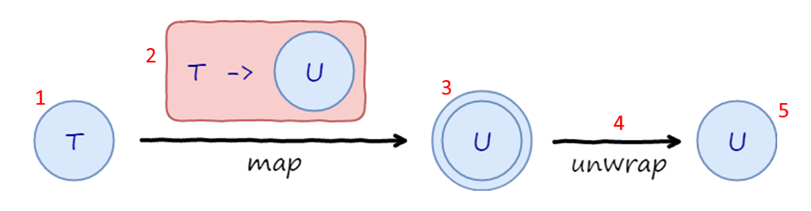
Step by step explanation
An instance of type T sits in a generic container
We call "AddStep" with a function, which maps T to U sitting inside yet another container
We get an instance of U but inside two containers
Two containers are automatically unwrapped into a single container to get back to the original shape
Now we are ready to add another step

Slide 93
Workflow pattern example
Here is how it would look:
This is the Monad pattern again ☺
WorkflowThatReturns<Lecture> Workflow(Academy academy)
{
return
academy
.GetStudent()
.AddStep(st => st.GetCourse())
.AddStep(c => c.GetLecture());
}

Slide 94
Let's see the Maybe monad
We have the following repository:
public interface IMaybeAwareRepository
{
Maybe<Customer> GetCustomer(int id);
Maybe<Address> GetAddress(int id);
Maybe<Order> GetOrder(int id);
}

Slide 95
Let's see the Maybe monad
We can easily chain it like this:
Maybe<Shipper> shipperOfLastOrderOnCurrentAddress =
repo.GetCustomer(customerId)
.FlatMap(c => c.Address)
.FlatMap(a => repo.GetAddress(a.Id))
.FlatMap(a => a.LastOrder)
.FlatMap(lo => repo.GetOrder(lo.Id))
.FlatMap(o => o.Shipper);

Slide 96
The task can be easily made monadic
With a little bit of helper methods, we can transform the Task:
repository
.GetAcademy()
.FlatMap(a => a.GetStudent())
.FlatMap(st => st.GetCourse())
.FlatMap(c => c.GetLecture())
.OnComplete(lecture => result.Add(lecture));

Slide 97
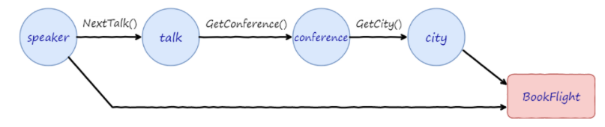
The task can be easily made monadic
The problem here is in non-sequential workflows:
repository
.LoadSpeaker()
.OnComplete(speaker =>
speaker
.NextTalk()
.Bind(talk => talk.GetConference())
.Bind(conference => conference.GetCity())
.OnComplete(city => reservations.BookFlight(speaker, city))
);

Slide 98
The async/await pattern
However, the Monad pattern is not a golden hammer
The async/await mechanism is better here
var speaker = await repository.LoadSpeaker();
var talk = await speaker.NextTalk();
var conference = await talk.GetConference();
var city = await conference.GetCity();
await reservations.BookFlight(speaker, city);

Slide 99
Practical applications

Slide 100
General tips for immutable architecture
Remove temporal coupling
Methods should not change state, they should work with inputs and outputs, if possible
Mutable state cannot be reduced to zero
So, you should consider every state separately
Keep in mind memory usages in certain scenarios
Deal with side effects by using CQRS
Commands – produce side effects and returns void
Queries – no side effects and returns data
By the return type you will know whether the method is pure or not
This approach is not 100% applicable

Slide 101
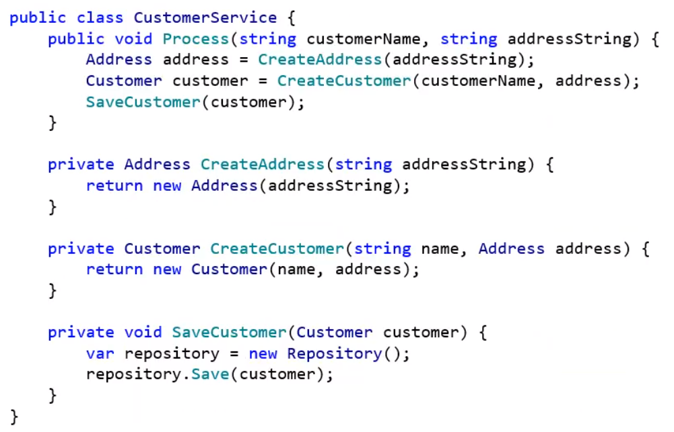
Immutability example

Slide 102
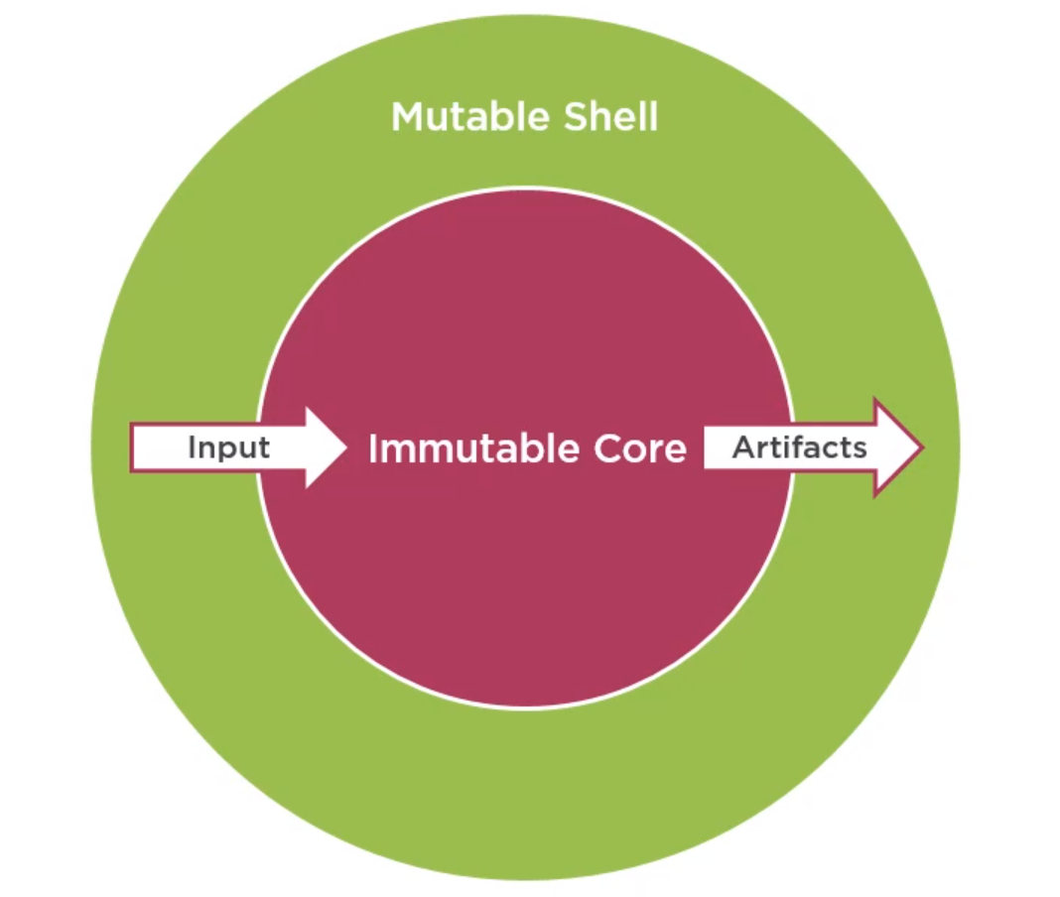
Application architecture

Slide 103
Exceptions
Methods which throw exceptions are not mathematical functions
They hide a possible outcome
You will never be sure whether an exception is caught without looking at implementation details
Using exceptions for control flow equals to using "goto" statements
Refactor exceptions to a "Result" object
Exceptions should signalize a bug
And not be used for expected results like user validation, for example
Catching exceptions should be done on a global application level

Slide 104
Avoid primitive obsession
Primitive obsession is using primitive variables for domain models
Makes your code dishonest
Violates the DRY principle
You need to introduce a new class for each concept in your codebase
For example, creating an "Email" class instead of using a string
Do not create a class for a single property without any logic behind it
For example, creating a "Money" class instead of using decimal may not be worth it
It depends on the logic you want to use for money in the application

Slide 105
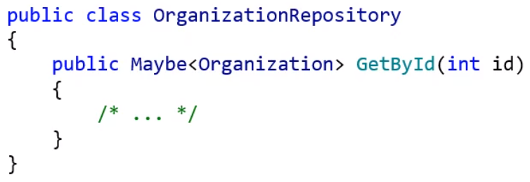
Remove nulls
If you can, use non-nullable reference types in your code
Most of the time, it is still not possible to make such a drastic change
Use the Maybe<T> struct type on your business logic

Slide 106
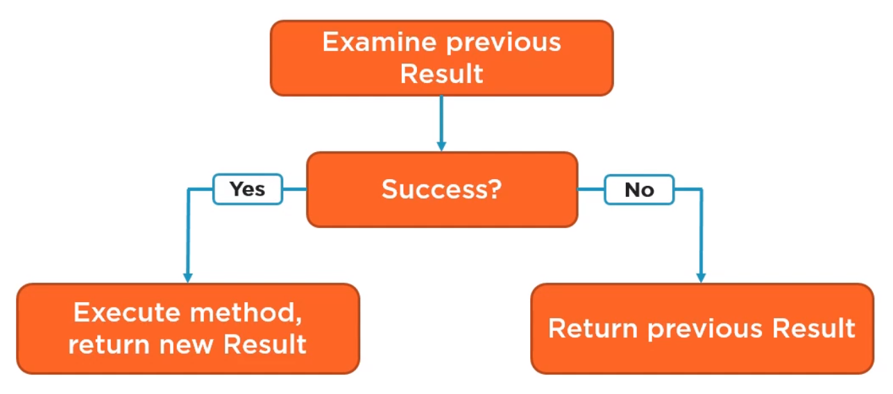
Use railway-oriented programming
Gives us the opportunity to invoke a delegate based on a Result
Success, Failure, or Both – making the class a Monad
Here is the "OnSuccess" workflow:

Slide 107
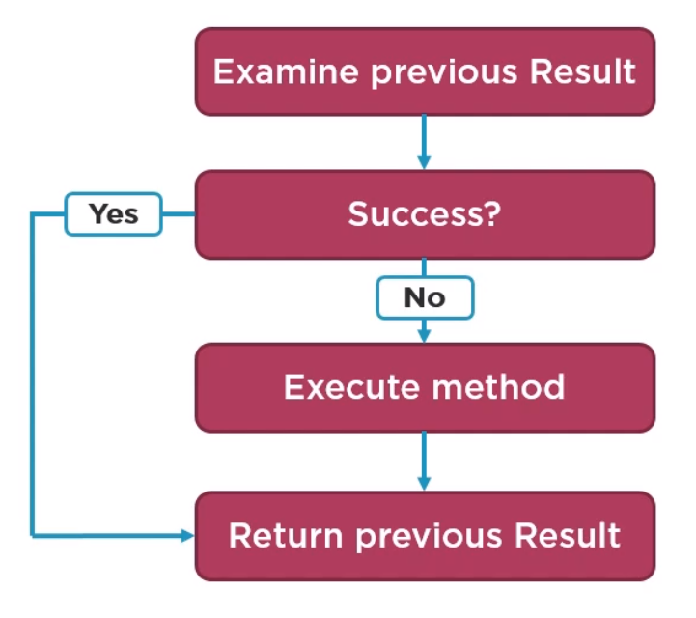
Use railway-oriented programming
Here is the "OnFailure" workflow:

Slide 108
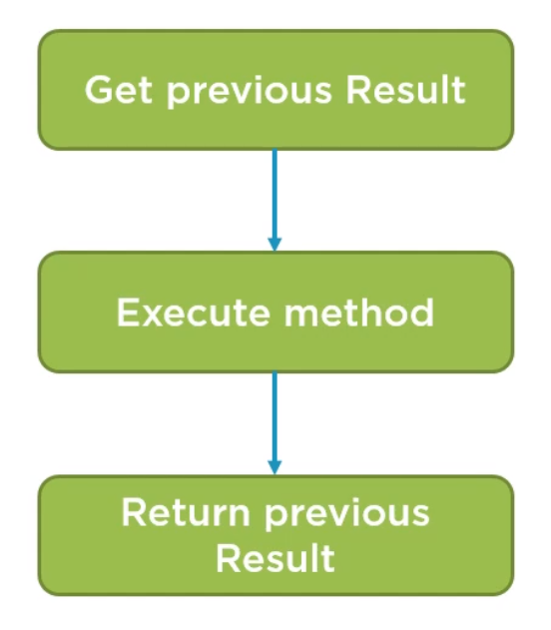
Use railway-oriented programming
And this is the "OnBoth" workflow:

Slide 109
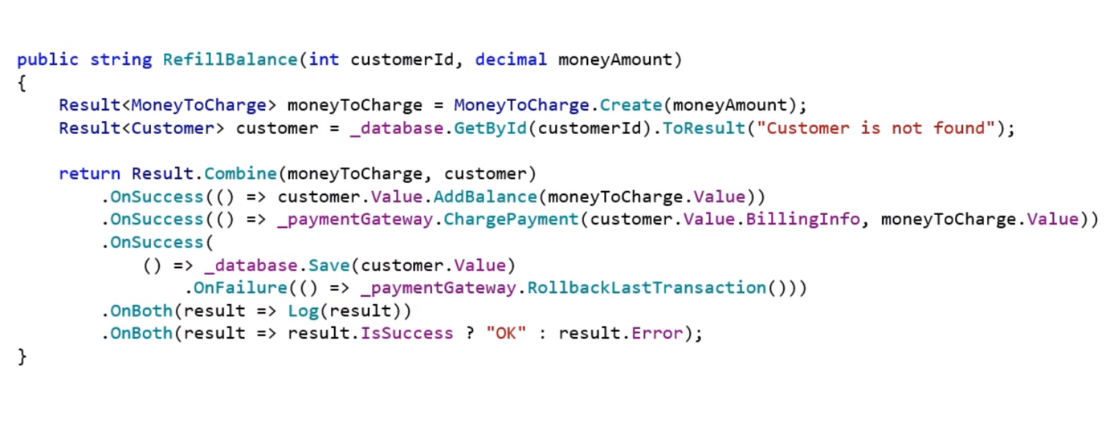
Use railway-oriented programming

Slide 110
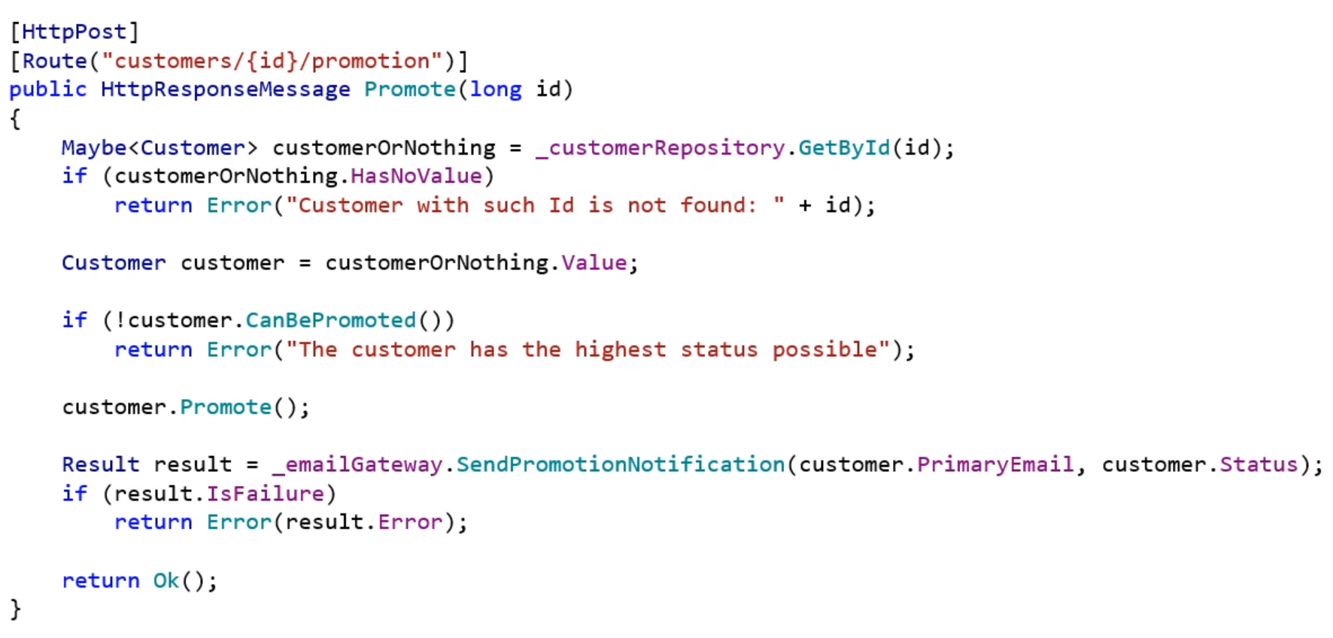
Use railway-oriented programming

Slide 111
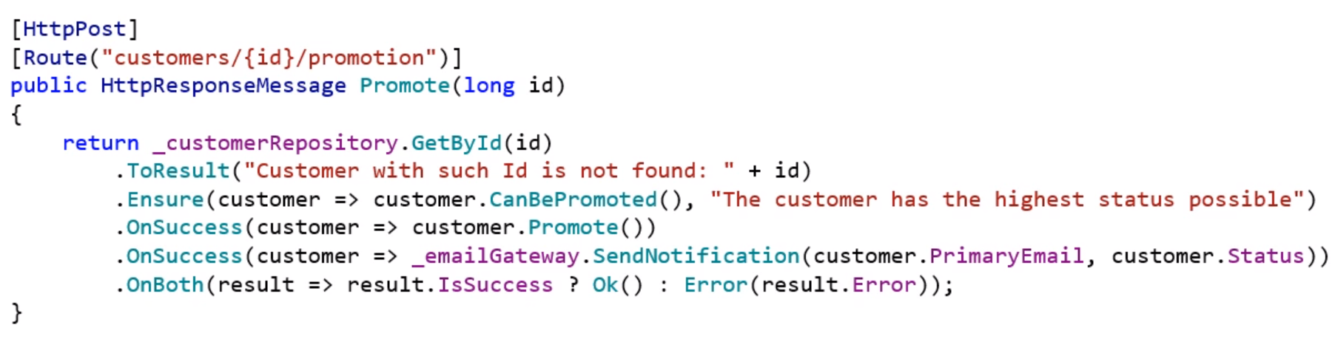
Use railway-oriented programming

Slide 112
Going even further

Slide 113
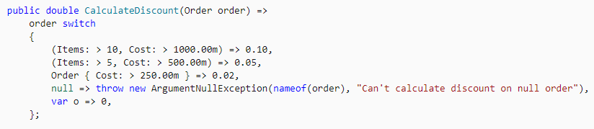
Pattern Matching
Learn the C# pattern matching functionality
https://docs.microsoft.com/en-us/dotnet/csharp/pattern-matching
It is a powerful technique and becomes better and better with each C# version
Here is an example technique:
https://medium.com/@slawomirsiudek/pattern-matching-is-exceptional-c-446317e982f7

Slide 114
Various other techniques
Immutable collections
Applicative (not that applicable to C#)
Using Unit instead of void
Using Discriminated Unions in C#
https://dev.to/integerman/oneof-us-discriminated-unions-in-c-3mnf
Combinators
https://github.com/louthy/language-ext/wiki/Thinking-Functionally:-Combinators
Checkout some functional libraries
language-ext - https://github.com/louthy/language-ext
Rx.NET - https://github.com/dotnet/reactive
C# Functional Extensions - https://github.com/vkhorikov/CSharpFunctionalExtensions

Slide 115
Or try a functional language ☺

Slide 116
A practical example

Slide 117
FINAL WORDS

Slide 118
Summary
About Code It Up
Caution About The Topic
Why Functional Programming
The Basic Requirements In C#
Common Concepts
Thinking Functionally
Functional Techniques
Functional Abstractions
Monads From Practice
Practical Applications
Going Even Further
Functional Libraries

Slide 119
Upcoming Code it up Events
Next events:
Enter the Swarm - Native Docker Clustering
Events with no specific order or dates:
Automate Your Process with CI/CD
The Limits of the C# Runtime
API Scenarios - REST, GraphQL & gRPC
Serverless Real-Time C# Applications On AWS? Yes, It’s Possible & Easy!
Software Engineering – Patterns & Anti-Patterns
Plus many more! For example Microservices Details?

Slide 120
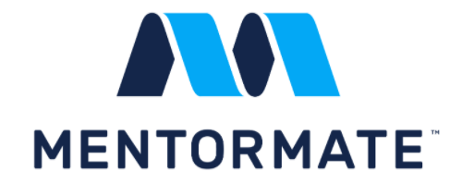
ANY QUESTIONS?
You can support me and my projects:
Via PayPal: http://paypal.me/ivaylokenov
Via Revolut: @ivaylowrlt
On Patreon: https://www.patreon.com/ivaylokenov
On Open Collective: https://opencollective.com/mytestedaspnet
Via Buy Me A Coffee: http://buymeacoff.ee/ivaylokenov
Crypto: http://bit.ly/ik-sponsors
Never expected, always appreciated!

Slide 121
Thank You!
presentation And Code available here: https://github.com/ivaylokenov/Let-s-Get-Functional-With-C-Sharp

